Slide 1




Running GenAI on Intel AI Laptops
Intel AI Laptops are designed for running GenAI applications. They feature powerful processors and GPUs, making them ideal for demanding AI workloads. The laptops are pre-configured with the necessary software and drivers, making it easy to get started with GenAI development and deployment.

Slide 2


Simple LLM Inference on CPU
LLM inference on CPUs is a straightforward process. The CPU executes the LLM model's instructions, generating text or performing other tasks. This method is suitable for simpler models or those running on devices without specialized hardware.
Speed
Cost
CPUs can be slower for complex models, especially for large language models.
CPUs are generally more affordable than GPUs, making them a cost-effective option for basic tasks.
Power Efficiency
CPUs are generally more power-efficient than GPUs, which is crucial for mobile devices.

Slide 3

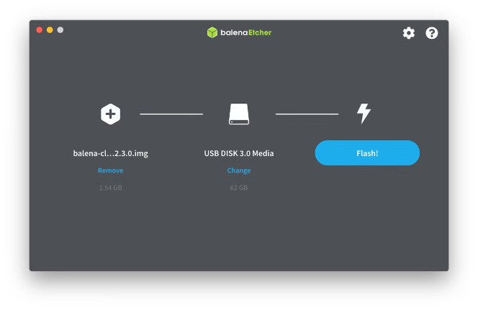
Fine-tuning of LLM Models using Intel® OpenVINO™
Intel® OpenVINO™ is a toolkit that optimizes deep learning models for Intel hardware. It provides tools and libraries for accelerating model inference and training, enabling efficient fine-tuning of LLMs on Intel AI Laptops.
1
Model Conversion
Convert the pre-trained model to an OpenVINO™ compatible format.
2
Fine-tuning
Train the model on a specific dataset to improve its performance on a particular task.
3
Deployment
Deploy the fine-tuned model on an Intel AI Laptop for optimized inference.

Slide 4





Building a chatbot
A chatbot can be built using a fine-tuned LLM. The model learns from training data and can generate natural language responses to user queries. Intel AI Laptops provide the computational power to run and optimize chatbot applications.
Data Collection
Gather training data that reflects the chatbot's intended use case.
Model Fine-tuning
Fine-tune an LLM on the collected data using Intel® OpenVINO™.
Chatbot Integration
Integrate the fine-tuned model into a chatbot framework.

Slide 5
Advantages of using Intel AI Laptops
Intel AI Laptops offer several benefits for GenAI development. They provide a balance of performance and portability, making them ideal for developers on the go. The laptops are also equipped with the necessary software and tools for building and deploying GenAI applications.
Performance
Portability
Software
Powerful processors and GPUs for handling complex AI workloads.
Lightweight and compact design for on-the-go development and deployment.
Pre-installed software and drivers for easy GenAI development.

Slide 6


Optimizing LLM inference on CPU
Optimizing LLM inference on CPUs involves techniques that enhance performance and efficiency. This can involve using specialized libraries, optimizing code, or utilizing hardware acceleration features.
1
Hardware Acceleration
2
Model Quantization
Intel® OpenVINO™ provides hardware acceleration features for Intel CPUs, enabling faster inference.
Reducing the precision of model weights can reduce memory usage and improve inference speed.
3
Code Optimization
Optimizing code for the CPU architecture can enhance inference performance.

Slide 7


Challenges in fine-tuning LLM models
Fine-tuning LLMs can be challenging due to the complexity of the models and the need for significant training data. The process requires expertise in deep learning and access to computational resources.
Data Requirements
LLMs require large amounts of high-quality data for effective fine-tuning.
Computational Resources
Fine-tuning LLMs can be computationally demanding, requiring powerful hardware.
Model Architecture
Understanding the model's architecture and its parameters is essential for effective fine-tuning.

Slide 8






Conclusion and key takeaways
Intel AI Laptops provide a powerful platform for running GenAI applications. The laptops' hardware and software capabilities facilitate LLM inference, fine-tuning, and chatbot development. Optimizing inference on CPUs and understanding the challenges of fine-tuning are key considerations for successful GenAI implementation.
Hardware
Software
Intel AI Laptops offer a balance of performance and portability.
Intel® OpenVINO™ enables efficient LLM fine-tuning and deployment.
Optimization
Applications
Techniques like hardware acceleration and model quantization can enhance inference efficiency.
GenAI on Intel AI Laptops can be used to build chatbots and other applications.

